Slide 1
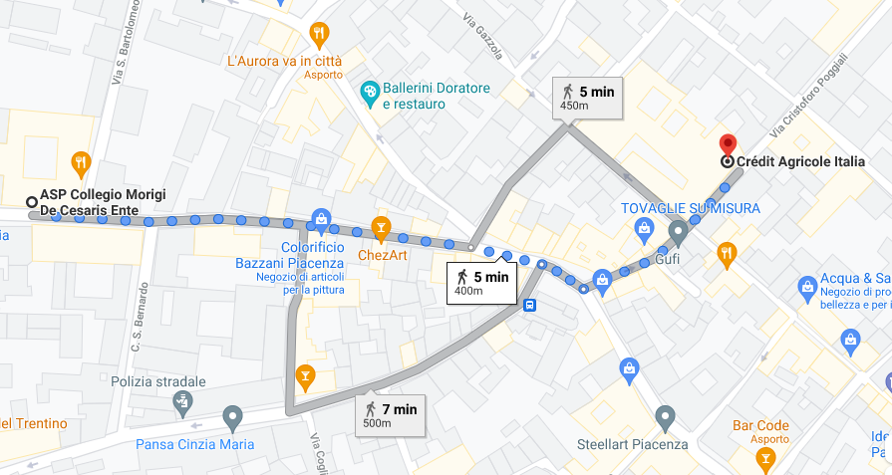
COLLEGIO MORIGI – CREDIT AGRICOLE ITALIA VIA POGGIALI

Slide 2
